Slide 1
A deep dive into development using SharePoint Framework
Vesa Juvonen,
Microsoft
Waldek Mastykarz
Rencore

Slide 2
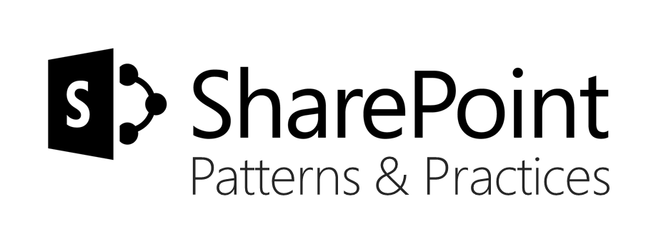
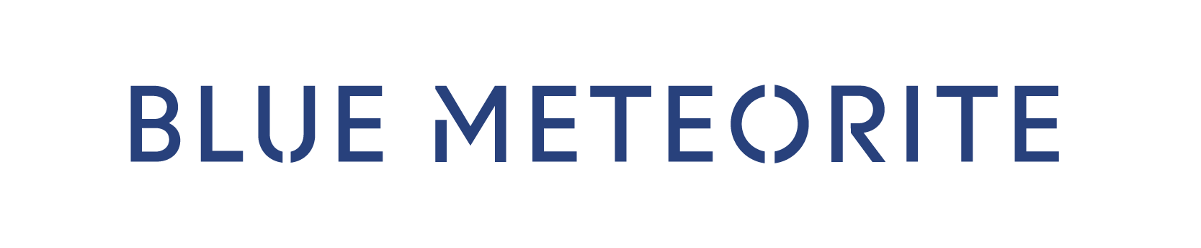

Sharing is caring…
Code samples
Guidance documentation
Monthly community calls
Case Studies
Themes
SharePoint Framework
SharePoint add-ins
Office 365 APIs, Microsoft Graph
Remote API models with SharePoint development
http://aka.ms/SharePointPnP

Slide 3
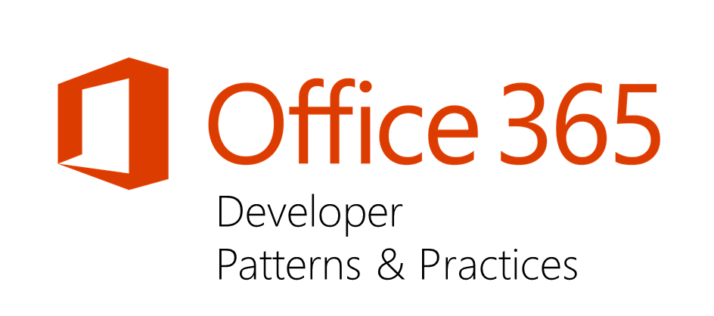


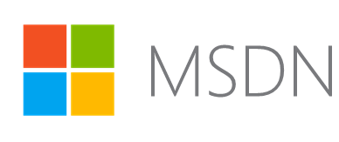
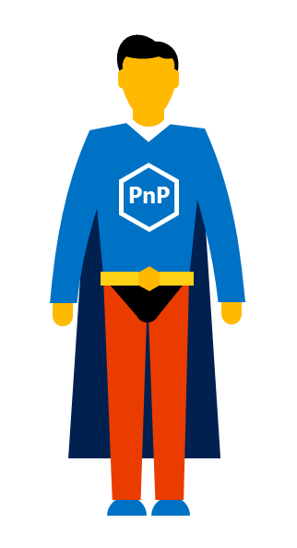


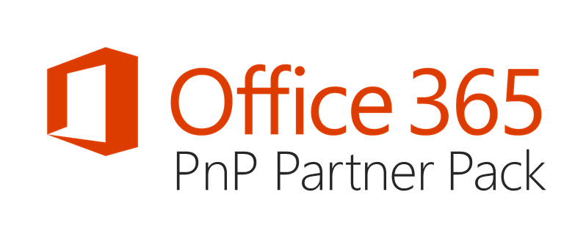

aka.ms/OfficeDevPnP aka.ms/SharePointPnP
https://github.com/OfficeDev/PnP
https://github.com/OfficeDev/PnP-Sites-Core
https://github.com/OfficeDev/PnP-PowerShell
https://github.com/OfficeDev/PnP-Tools
https://github.com/OfficeDev/PnP-JS-Core
https://github.com/OfficeDev/PnP-Guidance
https://github.com/OfficeDev/PnP-Transformation
https://github.com/OfficeDev/PnP-OfficeAddIns
https://github.com/OfficeDev/PnP-Provisioning-Schema
https://aka.ms/sppnp-videos
https://aka.ms/sppnp-msdn
Microsoft
Tech
Community
https://aka.ms/sppnp-community
https://docs.com/OfficeDevPnP
@OfficeDevPnP
http://aka.ms/sppnp-call
http://aka.ms/sppnp-jssig
https://aka.ms/sppnp-partner-pack

Slide 4
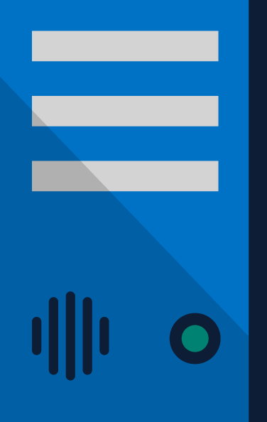
SharePoint Extensibility Principles
Build long-term, value-added services for enterprise mobility
Principles
To provide an Application Development Framework that aligns 1st and 3rd parties
To build industry leading client side solutions On-Premises and in the Cloud
Unlocking the potentials of SharePoint
and the Microsoft Graph on desktops
or any device
Notes:
Over the past several years, with the evolution of Office 365, development of SharePoint solutions has encountered a new set of challenges: while on one hand IT and Tenant administrators require a new set of tools to control how data get accessed and consumed in their tenancies, developers, on the other hand, want to programmatically control the whole lifecycle, experience, and data access capabilities of a Site.
Unfortunately, developers today find themselves constraint around building app parts as a result of iFrames, a reduced set of APIs, and no integration with cross Office 365 workloads. This in turn limits their ability to develop powerful portals that extend SharePoint.
The client-side development framework will deliver capabilities that will help both first party and third party developers build powerful, rich applications and provide an enjoyable web experience in Office 365 for end users that are both intuitive and simple to consume.

Slide 5
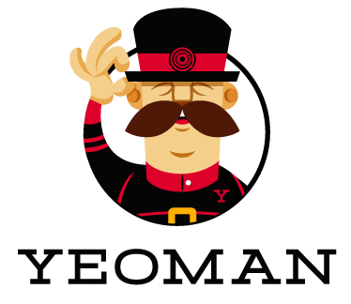

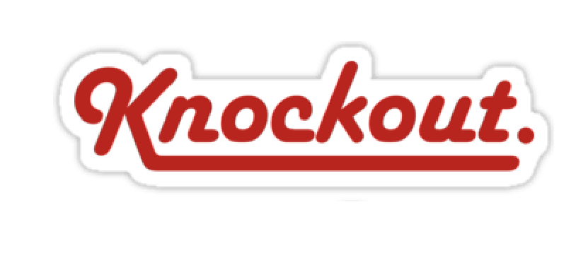
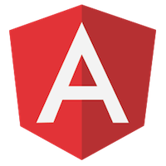
Typical tooling for SharePoint Framework
Tooling
  Node.js
  Yeoman
  Gulp
  TypeScript
  Visual Studio (Code)
Frameworks – Choose yours
  React
  Angular.js
  Knockout
  Etc.
Notes:
SharePoint will also support open source tooling to drive greater efficiencies when developing Parts and Apps. These tools should not be considered a replacement of an organizations traditional tools, but rather an extension of those, providing new opportunities to quickly get up and running with SharePoint development. If you’re familiar with Visual Studio development with SharePoint, this tools carry a lot of similarities with the tools you may already be familiar with for example:
Yeoman provides a generator ecosystem. A generator is basically a plugin that can be run with the `yo` command to scaffold complete projects or useful parts.
yo scaffolds out a new application, writing your build configuration (e.g Gruntfile, Gulpfile) and pulling in relevant build tasks and package manager dependencies (Bower, npm) that you might need for your build. This is similar to Project Scaffolding in Visual Studio.
Gulp
Automation - gulp is a toolkit that helps you automate painful or time-consuming tasks in your development workflow.
Platform-agnostic - Integrations are built into all major IDEs and people are using gulp with PHP, .NET, Node.js, Java, and other platforms.
Strong Ecosystem - Use npm modules to do anything you want + over 2000 curated plugins for streaming file transformations
Simple - By providing only a minimal API surface, gulp is easy to learn and simple to use
Node.js® is a JavaScript runtime built on Chrome's V8 JavaScript engine. Node.js uses an event-driven, non-blocking I/O model that makes it lightweight and efficient. Node.js' package ecosystem, npm, is the largest ecosystem of open source libraries in the world.
event driven JavaScript runtime, Node is designed to build scalable network applications similar to
VS SharePoint development: Gulp = MSBuild, NodeJS = IIS (Express), YeoMan = project scafolding in VS, TypeScript= typed superset of JavaScript

Slide 6


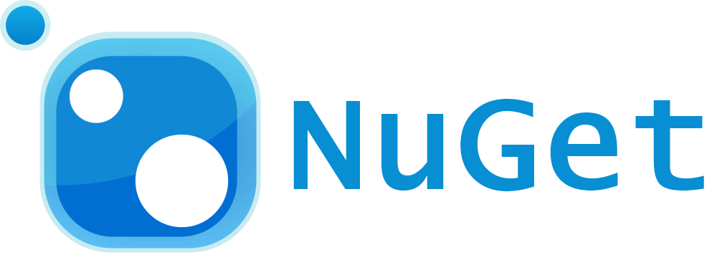
Web stack tooling compared to classic MS tools
IIS Express
MS Build
VS Project →
New → <Template>
C#

Slide 7
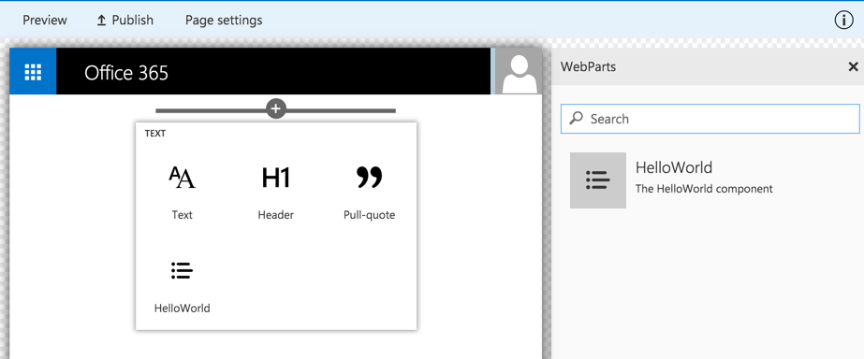
Client-side Web Part Build Flow
npm install generator-sharepoint -g
gulp serve
gulp package-solution
Install SharePoint Generator
Test
Package/Deploy
yo sharepoint
workbench
gulp upload-cdn
Scaffold SharePoint Web Part Project
Local
Package/Deploy
Code
manual upload of the app
Build Web Part Code
UAT / Pre-production
Release using app catalog*
Ship?
Available on Classic and Client-Side Pages

Slide 8
“I want to use Visual Studio as my development platform, what now?”

Slide 9

DEMO
How to use Visual Studio with Node.js projects

Slide 10
DEMO
Using SharePoint Framework with React or Angular (1.x)

Slide 11
aka.ms/SharePointPnP
https://github.com/SharePoint/sp-dev-docs
https://github.com/SharePoint/sp-dev-fx-webparts
More to come…
https://aka.ms/sppnp-videos
SharePoint Framework tutorials
Preparing for SharePoint Framework
what should I learn
Converting existing JS apps to SP Fx
Integrating Angular 1.x to SP Fx
Building simple SP Fx Web Part
Building Angular SP FX web parts
Microsoft
Tech
Community
https://aka.ms/sppnp-community
PnP is developer community for SharePoint
Target is to embrace sharing and help community to adapt new technologies
Community driven with community contributions
@OfficeDevPnP
http://aka.ms/sppnp-call
http://aka.ms/sppnp-jssig
“Sharing is caring!”

Slide 12

Q&A

